Slide 1
Properties of Transformations
Geometry
Chapter 9
Notes:
Geometry 9

Slide 2
This Slideshow was developed to accompany the textbook
  Larson Geometry
  By Larson, R., Boswell, L., Kanold, T. D., & Stiff, L.
  2011 Holt McDougal
Some examples and diagrams are taken from the textbook.
Slides created by
Richard Wright, Andrews Academy
rwright@andrews.edu

Slide 3
9.1 Translate Figures and Use Vectors
Transformation
  Moves or changes a figure
  Original called preimage (i.e. ΔABC)
  New called image (i.e. ΔA’B’C’)
Translation
  Moves every point the same distance in the same direction

Slide 4
9.1 Translate Figures and Use Vectors
Draw ΔRST with vertices R(2, 2), S(5, 2), and T(3, -2). Find the image of each vertex after the translation (x, y) → (x + 1, y + 2). Graph the image using prime notation.
Notes:
R’(3, 4), S’(6, 4), T’(4, 0)

Slide 5

9.1 Translate Figures and Use Vectors
The image of (x, y) → (x + 4, y – 7) is $\overline{P^{′}Q^{′}}$ with endpoints P’(-3, 4) and Q’(2, 1). Find the coordinates of the endpoints of the preimage.
Notes:
P: x + 4 = -3 → x = -7
y – 7 = 4 → y = 11 P(-7, 11)
Q: x + 4 = 2 → x = -2
y – 7 = 1 → y = 8 Q(-2, 8)

Slide 6
9.1 Translate Figures and Use Vectors
Isometry
  Transformation that preserves length and angle measure.
  A congruence transformation
Translation Theorem
A translation is an isometry.

Slide 7

9.1 Translate Figures and Use Vectors

Slide 8
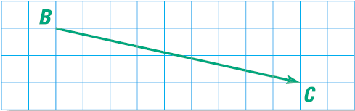

9.1 Translate Figures and Use Vectors
Vector ($\overset{⃑}{BC}$)
  Measurement with Direction and Magnitude (size)
  Represented by an arrow
  Component form $〈$hori, vert$〉$
    $\overset{⃑}{BC}=〈9,−2〉$
Horizontal Component
Initial Point
Vertical Component
Terminal Point
Notes:
Can be used to describe translations

Slide 9
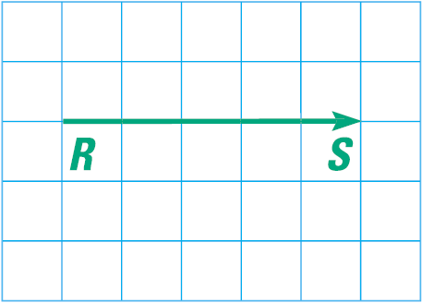
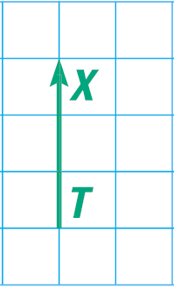
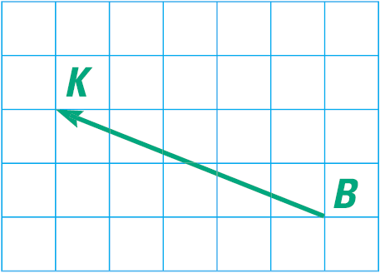
9.1 Translate Figures and Use Vectors
Name the vector and write its component form
Notes:
$$\overset{⃑}{RS}=〈5,0〉$$
$$\overset{⃑}{TX}=〈0,3〉$$
$$\overset{⃑}{BK}=〈−5,2〉$$

Slide 10

9.1 Translate Figures and Use Vectors
The vertices of ΔLMN are L(2, 2), M(5, 3), N(9, 1). Translate ΔLMN using vector $〈−2,6〉$.
576 #2-30 even, 34-40 even, 44, 48-54 even = 24
Notes:
Translation is (x, y)→(x-2, y+6)
L’(0, 8), M’(3, 9), N’(7, 7)

Slide 11
Answers and Quiz
9.1 Answers
9.1 Homework Quiz

Slide 12

9.2 Use Properties of Matrices
Matrix
  Rectangular arrangement of numbers in rows and columns
  Each number is an element
  $\left[\begin{matrix} & 1 & 2 & 3 \\ & 4 & 5 & 6\end{matrix}\right]$
  Dimension rows x columns
    2 x 3
Row
Column

Slide 13
9.2 Use Properties of Matrices
Write a matrix to represent ΔABC with vertices A(3, 5), B(6, 7), C(7, 3).
How many rows and columns are in a matrix for a hexagon?
Notes:
x-coordinates go in first row; y-coordinates go in second row
$$\left[\begin{matrix}3 & 6 & 7 \\ 5 & 7 & 3\end{matrix}\right]$$
2 rows, 6 columns

Slide 14

9.2 Use Properties of Matrices
Add and Subtract Matrices
  Dimension must be equal
  Add corresponding elements
$\left[\begin{matrix}1 & −4 \\ 3 & −5\end{matrix}\right]−\left[\begin{matrix}2 & 3 \\ 7 & 8\end{matrix}\right]$
Notes:
$$\left[\begin{matrix}−1 & −7 \\ −4 & −13\end{matrix}\right]$$

Slide 15

9.2 Use Properties of Matrices
The matrix $\left[\begin{matrix}1 & 2 & 6 & 7 \\ 2 & −1 & 1 & 3\end{matrix}\right]$ represents quadrilateral JKLM. Write the translation matrix and the image matrix that represents the translation of JKLM 4 units right and 2 units down. Then find the coordinates of the image.
Notes:
Translation matrix $\left[\begin{matrix}4 & 4 & 4 & 4 \\ −2 & −2 & −2 & −2\end{matrix}\right]$
Image coordinates $\left[\begin{matrix}1 & 2 & 6 & 7 \\ 2 & −1 & 1 & 3\end{matrix}\right]+\left[\begin{matrix}4 & 4 & 4 & 4 \\ −2 & −2 & −2 & −2\end{matrix}\right]=\left[\begin{matrix}5 & 6 & 10 & 11 \\ 0 & −3 & −1 & 1\end{matrix}\right]$

Slide 16
9.2 Use Properties of Matrices
Matrix Multiplication
Matrix multiplication can only happen if the number of columns of the first matrix is the same as the number of rows on the second matrix.
You can multiply a 3x5 with a 5x2.
  3x5 ⋅ 5x2 → 3x2 will be the dimensions of the answer
Because of this order does matter!

Slide 17






9.2 Use Properties of Matrices
$$\left[\begin{matrix}5 & 1\end{matrix}\right]⋅\left[\begin{matrix}−3 \\ −2\end{matrix}\right]$$
$$5⋅−3$$
$$+1⋅−2$$
$$[−17]$$

Slide 18














9.2 Use Properties of Matrices
$$\left[\begin{matrix}1 & 2 \\ 0 & −3\end{matrix}\right]⋅\left[\begin{matrix}−2 & 1 \\ 4 & 3\end{matrix}\right]$$
$$1⋅−2$$
$$+2⋅4$$
$$1⋅1+2⋅3$$
$$0⋅−2+−3⋅4$$
$$0⋅1+−3⋅3$$
$$6$$
$$7$$
$$−12$$
$$−9$$

Slide 19
9.2 Use Properties of Matrices
584 #2-32 even, 33, 38-44 even = 21
Extra Credit 587 #2, 6 = +2

Slide 20
Answers and Quiz
9.2 Answers
9.2 Homework Quiz

Slide 21
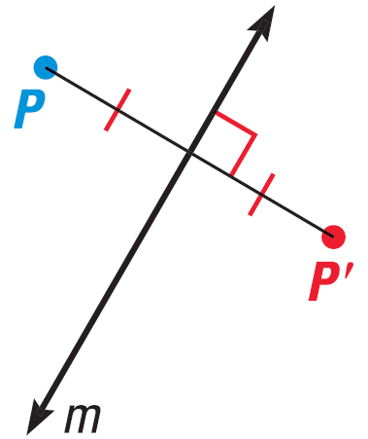
9.3 Perform Reflections
Reflection
  Transformation that uses a line like a mirror to reflect an image.
  That line is called Line of Reflection
  P and P’ are the same distance from the line of reflection
  The line connecting P and P’ is perpendicular to the line of reflection

Slide 22
9.3 Perform Reflections
Graph a reflection of ΔABC where A(1, 3), B(5, 2), and C(2, 1) in the line x = 2.
Notes:
New points are A(3, 3), B(-1, 2), C(2, 1)

Slide 23
9.3 Perform Reflections
Coordinate Rules for Reflections
  Reflected in x-axis: (a, b) → (a, -b)
  Reflected in y-axis: (a, b) → (-a, b)
  Reflected in y = x: (a, b) → (b, a)
  Reflected in y = -x: (a, b) → (-b, -a)
Reflection Theorem
A reflection is an isometry.

Slide 24
9.3 Perform Reflections
Graph ΔABC with vertices A(1, 3), B(4, 4), and C(3, 1). Reflect ΔABC in the lines y = -x and y = x.
Notes:
y = -x: new points A(-3, -1), B(-4, -4), C(-1, -3)
y = x: new points A(3, 1), B(4, 4), C(1, 3)

Slide 25


9.3 Perform Reflections
Reflection Matrix
  You can find the reflection of a polygon using matrix multiplication
  Write the polygon vertices as a matrix
  Multiply by $\left[\begin{matrix}1 & 0 \\ 0 & −1\end{matrix}\right]$ for x-axis
    Or $\left[\begin{matrix}−1 & 0 \\ 0 & 1\end{matrix}\right]$ for y-axis
  [Reflection Matrix] [Polygon Matrix] = [Image Matrix]
$\left[\begin{matrix}0 & 1 \\ 1 & 0\end{matrix}\right]$ for y = x
$\left[\begin{matrix}0 & −1 \\ −1 & 0\end{matrix}\right]$ for y = -x
Notes:
Isometry: size and shape are unchanged

Slide 26
9.3 Perform Reflections
The vertices of ΔLMN are L(-3, 3), M(1, 2), and N(-2, 1). Find the reflection of ΔLMN in the y-axis.
593 #4-24 even, 28, 40, 42-46 all = 18
Notes:
$$\left[\begin{matrix}−1 & 0 \\ 0 & 1\end{matrix}\right]⋅\left[\begin{matrix}−3 & 1 & −2 \\ 3 & 2 & 1\end{matrix}\right]$$
$$\left[\begin{matrix}3 & −1 & 2 \\ 3 & 2 & 1\end{matrix}\right]$$

Slide 27
Answers and Quiz
9.3 Answers
9.3 Homework Quiz

Slide 28
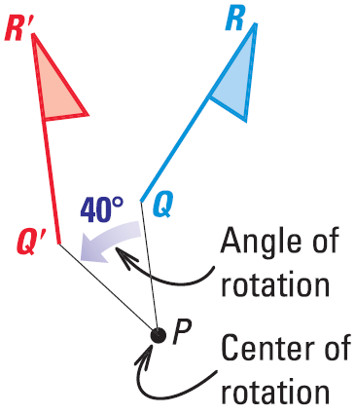
9.4 Perform Rotations
Rotation
  Figure is turned about a point called center of rotation
  The amount of turning is angle of rotation
Rotation Theorem
A rotation is an isometry.

Slide 29
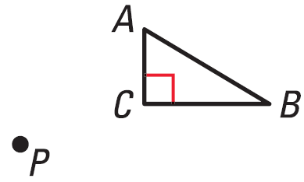
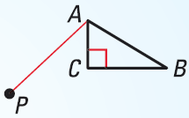
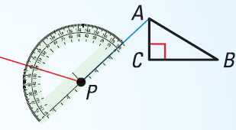

9.4 Perform Rotations
Draw a 120° rotation of ΔABC about P.
Draw a segment from A to P.
Draw a ray to form a 120° angle with $\overline{PA}$

Slide 30
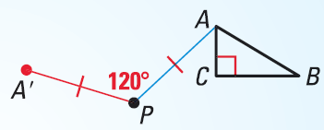
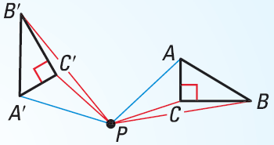
9.4 Perform Rotations
Draw A’ so that PA’ = PA
Repeat steps 1-3 for each vertex. Draw ΔA’B’C’.

Slide 31
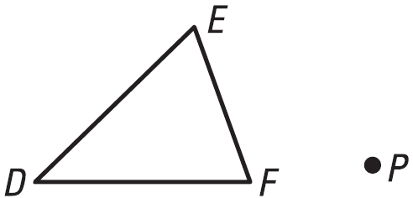
9.4 Perform Rotations
Draw a 50° rotation of ΔDEF about P.

Slide 32
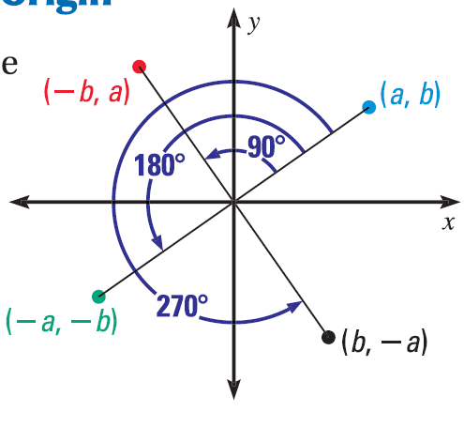
9.4 Perform Rotations
Coordinate Rules for Counterclockwise Rotations about the Origin
90°: (a, b) → (-b, a)
180°: (a, b) → (-a, -b)
270°: (a, b) → (b, -a)

Slide 33

9.4 Perform Rotations
Rotation Matrices (counterclockwise)
90°: $\left[\begin{matrix}0 & −1 \\ 1 & 0\end{matrix}\right]$
180°: $\left[\begin{matrix}−1 & 0 \\ 0 & −1\end{matrix}\right]$
270°: $\left[\begin{matrix}0 & 1 \\ −1 & 0\end{matrix}\right]$
360°: $\left[\begin{matrix}1 & 0 \\ 0 & 1\end{matrix}\right]$
[Rotation Matrix] [Polygon Matrix] = [Image Matrix]

Slide 34
9.4 Perform Rotations
If E(-3, 2), F(-3, 4), G(1, 4), and H(2, 2). Find the image matrix for a 270° rotation about the origin.
602 #4-28 even, 32, 36-40 even, 41-46 all = 23
Notes:
$$\left[\begin{matrix}0 & 1 \\ −1 & 0\end{matrix}\right]⋅\left[\begin{matrix}−3 & −3 & 1 & 2 \\ 2 & 4 & 4 & 2\end{matrix}\right]$$
$$\left[\begin{matrix}2 & 4 & 4 & 2 \\ 3 & 3 & −1 & −2\end{matrix}\right]$$

Slide 35
Answers and Quiz
9.4 Answers
9.4 Homework Quiz

Slide 36
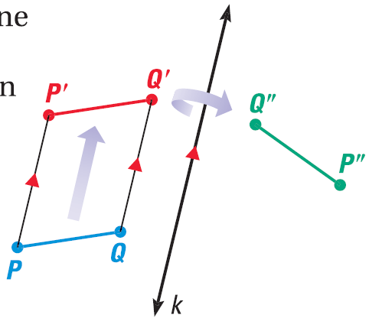
9.5 Apply Compositions of Transformations
Composition of Transformations
  Two or more transformations combined into a single transformation
Glide Reflection
  Translation followed
  by Reflection

Slide 37
9.5 Apply Compositions of Transformations
The vertices of ΔABC are A(3, 2), B(-1, 3), and C(1, 1). Find the image of ΔABC after the glide reflection.
  Translation: (x, y) → (x, y – 4)
  Reflection: Over y-axis
Notes:
New points after translation: A’(3, -2), B’(-1, -1), C’(1, -3)
New points after reflection: A’’(-3, -2), B’’(1, -1), C’’(-1, -3)

Slide 38
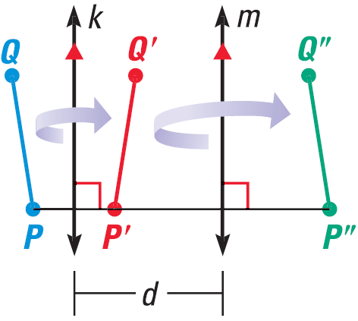
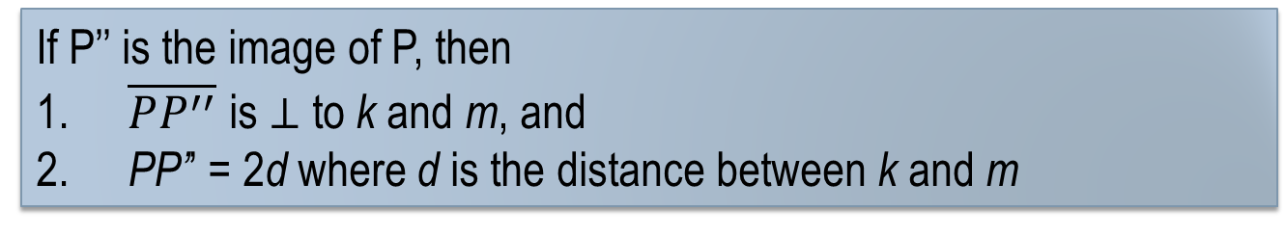
9.5 Apply Compositions of Transformations
Composition Theorem
A composition of two (or more) isometries is an isometry.
Reflections in Parallel Lines Theorem
If lines k and m are parallel, then a reflection in line k followed by a reflection in line m is the same as a translation.
If P’’ is the image of P, then
$\overline{PP^{′′}}$ is $⊥$ to k and m, and
PP’’ = 2d where d is the distance between k and m

Slide 39
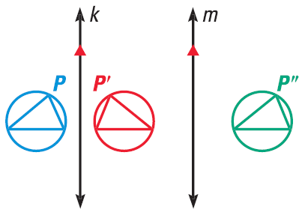
9.5 Apply Compositions of Transformations
Use the figure below. The distance between line k and m is 1.6 cm.
The preimage is reflected in line k, then in line m. Describe a single transformation that maps the blue figure to the green.
What is the distance from P
and P’’?
Notes:
Translation in the x direction
2(1.6 cm) = 3.2 cm (Reflections in Parallel Lines Thrm)

Slide 40
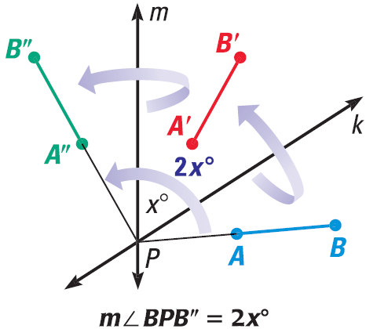
9.5 Apply Compositions of Transformations
Reflections in Intersecting Lines Theorem
If lines k and m intersect at point P, then a reflection in line k followed by a reflection in line m is the same as a rotation about point P.
The angle of rotation is 2x°, where x° is the measure of the acute or right angle formed k and m.

Slide 41
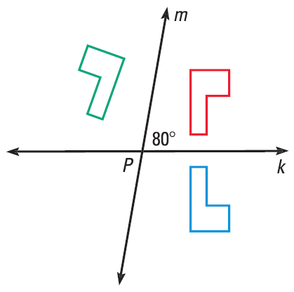
9.5 Apply Compositions of Transformations
In the diagram, the preimage is reflected in line k, then in line m. Describe a single transformation that maps the blue figure to the green.
611 #2-30 even, 40-48 even = 20
Extra Credit 615 #2, 8 = +2
Notes:
Counterclockwise rotation of 160° about point P

Slide 42
Answers and Quiz
9.5 Answers
9.5 Homework Quiz

Slide 43
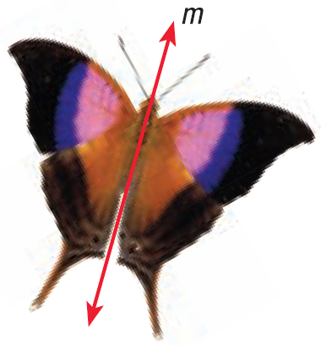
9.6 Identify Symmetry
Line symmetry
  The figure can be mapped to itself by a reflection
  The line of reflection is called Line of Symmetry
Humans tend to think that symmetry is beautiful

Slide 44


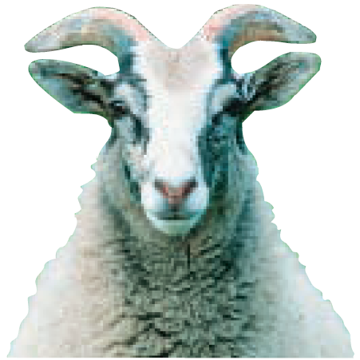
9.6 Identify Symmetry
How many lines of symmetry does the object appear to have?
Notes:
Flower: 4 lines of symmetry
Sea Star: 5 lines of symmetry
Goat: 1 line of symmetry

Slide 45
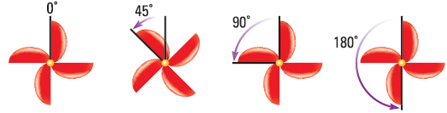
9.6 Identify Symmetry
Rotational Symmetry
  The figure can be mapped to itself by a rotation of 180° or less about the center of the figure
  The center of rotation is called the Center of Symmetry
Notes:
Note: the 45° is not a symmetry

Slide 46

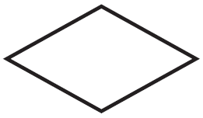
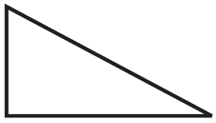
9.6 Identify Symmetry
Does the figure have rotational symmetry? What angles?
621 #4-20 even, 24-34 even, 37-45 all = 24
Notes:
Rhombus: 180°
Octagon: 90°, 180°
Triangle: none

Slide 47
Answers and Quiz
9.6 Answers
9.6 Homework Quiz

Slide 48
9.7 Identify and Perform Dilations
Dilation
  Enlarge or reduce
  Image is similar to preimage
  Scale factor is k
    If 0 < k < 1, then reduction
    If k > 1, then enlargement

Slide 49
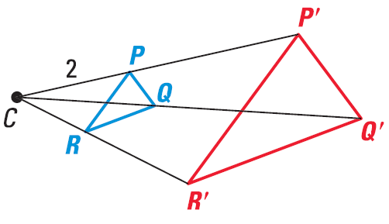

9.7 Identify and Perform Dilations
The image point P’ lies on $\vec{CP}$. The scale factor k is a positive number such that $k=\frac{CP^{′}}{CP}$ and $k≠1$
Scale factor is $\frac{\text{image}}{\text{preimage}}$
Notes:
Scale

Slide 50

9.7 Identify and Perform Dilations
Draw and label ΔRST, then construct a dilation of ΔRST with R as the center of dilation and a scale factor of 3.
Draw ΔRST, then draw rays $\vec{RS}$ and $\vec{RT}$
Using a ruler, measure RS. Multiply by the scale factor. Using the ruler mark this length RS’ on $\vec{RS}$. Repeat for the other rays.
Draw ΔR’S’T’

Slide 51

9.7 Identify and Perform Dilations
Scalar matrix multiplication
  When you multiply a number by matrix, distribute to each element.
Simplify
$5⋅\left[\begin{matrix}2 & 1 & −10 \\ 3 & −4 & 7\end{matrix}\right]$
Notes:
$$\left[\begin{matrix}10 & 5 & −50 \\ 15 & −20 & 35\end{matrix}\right]$$

Slide 52
9.7 Identify and Perform Dilations
Dilation using matrices (center at origin)
  Scale factor [polygon matrix] = [image matrix]
The vertices of ΔRST are R(1, 2), S(2, 1), and T(2, 2). Use scalar multiplication to find the vertices of ΔR’S’T’ after a dilation with its center at the origin and a scale factor of 2.
629 #2-28 even, 32-36 even, 40, 43-49 all = 25
Extra Credit 632 #2, 6 = +2
Notes:
$$2\left[\begin{matrix}1 & 2 & 2 \\ 2 & 1 & 2\end{matrix}\right]$$
$$\left[\begin{matrix}2 & 4 & 4 \\ 4 & 2 & 4\end{matrix}\right]$$

Slide 53
Answers and Quiz
9.7 Answers
9.7 Homework Quiz

Slide 54
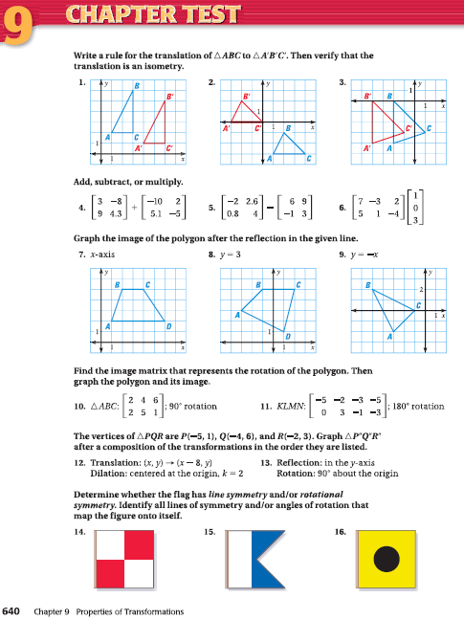
9.Review
640 #1-16 all = 16

